Slide 1
OGC API – Tiles Sprint
Webinar
16th April 2020

Slide 2
Webinar Agenda
Welcome - Gobe Hobona (OGC)
Motivation for the Sprint - Michael Gordon (Ordnance Survey)
OGC API - Tiles draft specification - Joan Maso (UAB - CREAF)
OGC API – Common draft specification - Chuck Heazel (Heazel Tech)
Description of sprint - Gobe Hobona (OGC)
Questions & Answers

Slide 3
Welcome
OGC and Ordnance Survey invite you to the OGC API – Tiles Sprint being held virtually on:
Day 1: Thursday 23rd April from 09:00am BST / 10:00am CEST / 04:00am EDT
Day 2: Friday 24th April, 2020 from 09:00am BST / 10:00am CEST / 04:00am EDT
Finishing at 05:00pm BST / 06:00pm CEST / 12:00pm EDT
What is an OGC Sprint?
A collaborative and inclusive event driven by innovative and rapid programming with minimum process and organization constraints to support the development of new applications and open standards.

Slide 4
Motivation for the Sprint
Ensuring there are modern API standards for common app elements
WMTS is the most used OGC web service standard – let’s make sure the
next generation is too!
Over the next few years, OS will be creating the next-generation of
authoritative data for Great Britain
– we want to provide access using modern, easy to use OGC standards ☺

Slide 5
OGC API - Tiles draft specification

Slide 6
OGC API – Common draft specification

Slide 7
Description of the sprint

Slide 8
Sprint Description
The scope of the code sprint is to include API development and testing, using one or more implementations of OpenAPI 3.0 (the successor of Swagger).
Participants are welcome to bring partial or complete implementations of servers or clients to support the sprint.
Participants will have the opportunity to experiment with parts of the specification and develop working services.
This development can either be done with:
source data that participants bring to the event themselves, or
source data made available by Ordnance Survey, such as OS Open ZoomStack.

Slide 9
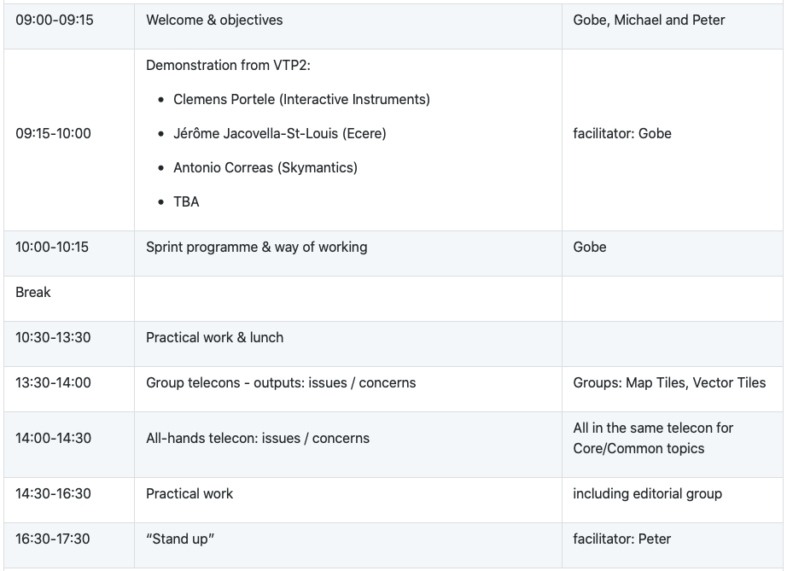
Sprint Schedule – April 23rd, 2020
Implement the API spec &
log any issues encountered
Discuss issues encountered in two groups: Map Tiles, Vector Tiles
Discuss overarching issues affecting Core Tiles API or Common
Implement the API spec &
log any issues encountered
Report back on progress

Slide 10
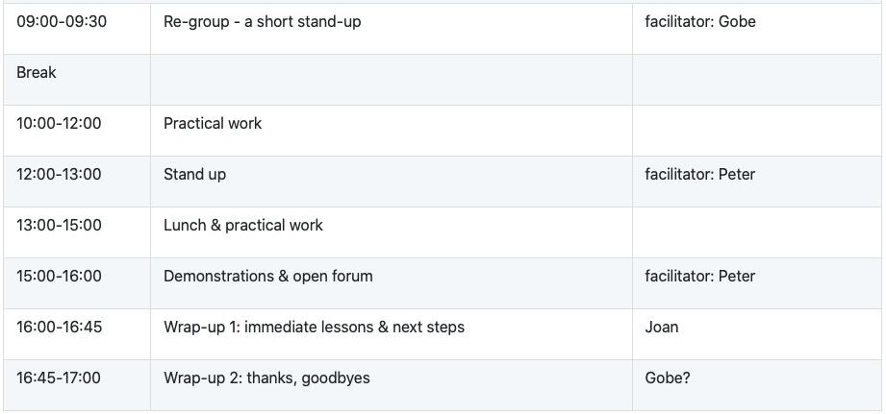
Sprint Schedule – April 24th, 2020

Slide 11

Logistics
Gotomeeting
Link to be provided to registered participants only.
Gitter
https://gitter.im/opengeospatial/OGC-OS-Sprint-04-2020
GitHub
Public repo https://github.com/opengeospatial/OGC-OS-Sprint-04-2020
OGC API – Tiles issues https://github.com/opengeospatial/OGC-API-Tiles/issues
Other Sprint issues https://github.com/opengeospatial/OGC-OS-Sprint-04-2020/issues

